Slide 1
Donation Management System Company Name : G for Donation
Md Mostafa Kamal Anna
Mahbub Morshed
Syed Irfan Shabab
Rohit Kumar Chowdhury
Tanjilul Islam

Slide 2
IntroDuction
The Donation Management System is a web-based platform designed to facilitate charitable fundraising efforts and streamline the process of donating to various causes. In today's interconnected world, there's an increasing need for efficient and transparent systems to manage donations and connect fundraisers with potential donors. This system aims to address these needs by providing a user-friendly interface for both fundraisers and donors to interact, manage campaigns, and track donations effectively.

Slide 3
Background
In the landscape of charitable giving, the traditional methods of fundraising and donation management often lack efficiency and transparency. Manual processes can be time-consuming and prone to errors, leading to challenges in tracking donations and engaging with donors effectively. Recognizing these limitations, the Donation Management System emerges as a solution to bridge the gap between fundraisers and donors.

Slide 4
Motivation
Our journey with the Donation Management System began as a project assigned by our esteemed course instructor. However, what truly fueled our passion and dedication was witnessing the impactful work of real-life fundraising organizations, such as Bangladesh Donate Foundation. Observing the tireless efforts of these organizations to make a difference in the world inspired us to delve deeper into our project.

Slide 5
Problems that can be fixed
Manual Processes: Traditional methods of fundraising and donation management rely heavily on manual processes, leading to inefficiencies, errors, and delays.
Lack of Transparency: Donors often lack visibility into how their contributions are utilized, leading to concerns about accountability and trust.
Limited Engagement: Fundraisers struggle to effectively engage with donors, resulting in missed opportunities to cultivate relationships and secure ongoing support.
Difficulty in Tracking: Without robust tracking mechanisms, it's challenging for fundraisers to monitor donations, assess campaign performance, and make informed decisions.

Slide 6
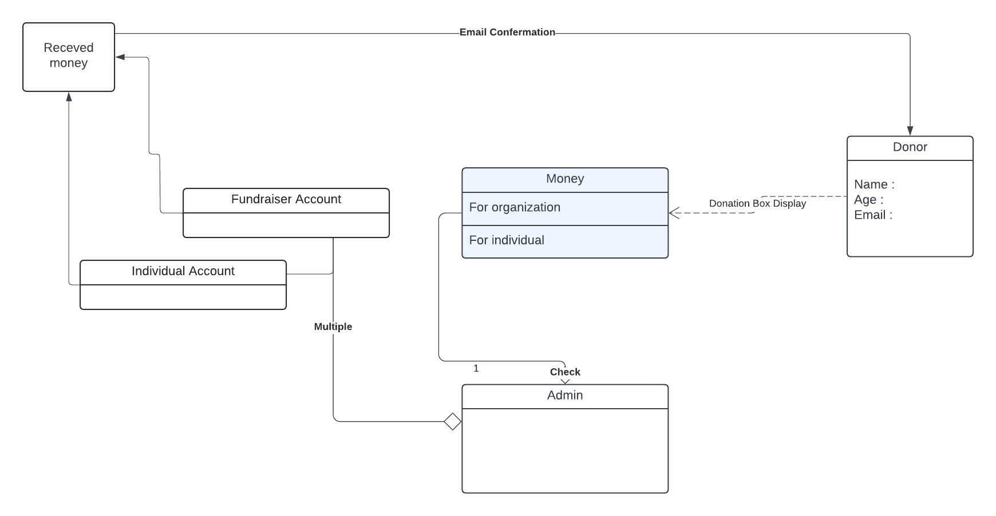
Project
Key Elements
1 Campaign Creation and Management
2 Donation Tracking and Reporting
3 Search and Discovery
4 Transparency and Accountability
Uml Diagram

Slide 7
Scope
User Management
Campaign Management
Donation Processing
Search and Filter Functionality
Transparency Features
Reporting and Analytics
Admin Panel

Slide 8
Tasks and time plan
$ Requirements Gathering (2 weeks)
Team: Md Mostafa Kamal Anna, Mahbub Morshed, Syed Irfan Shabab
Tasks: Conduct stakeholder meetings to gather requirements.
$ System Design (3 weeks)
Team: Rohit Kumar Chowdhury, Tanjilul Islam
Tasks: Design system architecture.Develop wireframes and UI/UX designs
$ Development (8 weeks)
$ Testing (2 weeks)
$ Deployment (1 week) $ Maintenance and Support (will be Ongoing)

Slide 9
Budget and Resources Costs
Team | Money
Md Mostafa Kamal Anna (Project Manager) | ৳10,000
Mahbub Morshed (Business Analyst) | ৳8,000
Syed Irfan Shabab (Developer) | ৳15,000
Rohit Kumar Chowdhury (Developer) | ৳15,000
Tanjilul Islam (Designer) | ৳12,000
Total | ৳70,000

Slide 10
Conclusion
In conclusion, the Donation Management System aims to streamline the process of fundraising by providing a platform where fundraisers can create campaigns and donors can contribute to meaningful causes. By leveraging technology, the system facilitates transparent and efficient fundraising efforts, allowing users to connect with charitable organizations and make a positive impact on society.
References
GoFundMe: A popular crowdfunding platform that allows individuals and organizations to create fundraising campaigns for various causes, including medical expenses, education, and emergencies. Website: https://www.gofundme.com/
DonorsChoose: A platform specifically for fundraising campaigns related to education. Teachers can create projects to request funding for classroom supplies, equipment, and educational experiences. Website: https://www.donorschoose.org/

